Slide 1
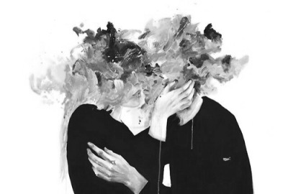

How Do I Love Thee

