Slide 1
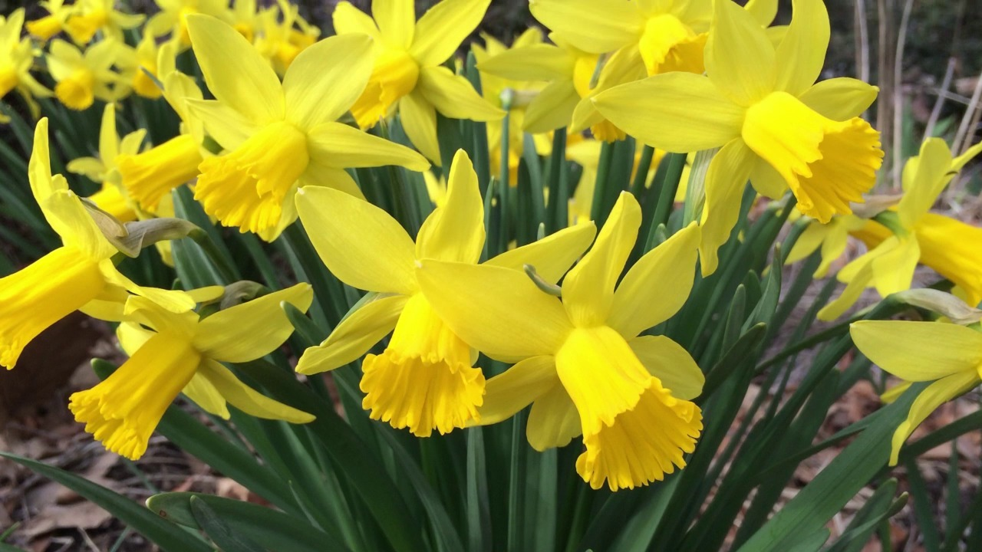

I Wondered Lonely as a Cloud

